Slide 1
Distributing Supply Chain Artifacts with OCI & ORAS Artifacts
Steve Lasker
Principal PM Architect
Azure
Steve.Lasker@Microsoft.com
@SteveLasker
SteveLasker.blog
github.com/SteveLasker
github.com/SteveLasker/presentations

Slide 2
Working Agenda
You have a bunch of new supply chain artifacts, where are you going to store them?
Registries as common distribution points – why?
How many storage systems do we need?
What makes registries so good for new types (YASS)
Registries Elegance and Evolution
Elegance
The constructs of a registry
Manifests, Blobs
Lifecycle
OCI Artifacts – generalizing container images
Evolution
ORAS Artifacts for reference types

Slide 3
Agenda
Supply Chain Artifacts:
What will you use to store all the new artifact types?
Why the “what” matters
Build or Extend?
Registries
Elegance and Evolution
OCI and ORAS Artifacts

Slide 4
Supply Chain Artifacts
Yeah, and ohhh my

Slide 5
Supply Chain Artifacts – What/Where
Software
SBOM
Containers
Packages
Binaries
IoT Deployments
Vehicles to Medical
Virtual Machine Images
Scan Results
Claims
Licenses
gitBOM
Policies
Attestations
Docs
Deployment Templates

Slide 6
Supply Chain Artifacts – What/Where
What is the artifact you’re looking to store?
A signature?
A single file (binary, json, yaml)?
A collection of files?
A file(s), with an SBOM?
…which is also signed?
Does each artifact have a “version”?
How to manage lifecycle?
Notes:
You’re already building the thing, and all the experiences around the thing
What do you do for storage?
Build yet another storage solution (YASS)?
Leverage an existing solution?

Slide 7
Supply Chain Artifacts – What/Where
Where will you store them?
Will you distribute them?
How will you manage their lifecycle?
Notes:
Lets skip where for a second
Will you distribute?
For the things you depend upon (build and run), should you have possession of, at least, the latest version you depend upon?
Should you depend on them from the public internet?
Or, did you import it to your private/controlled environment?

Slide 8
Supply Chain Artifact Distribution
Best practice: Own a copy of your dependencies, in an environment you own
Ship the SBOM, gitBOM, Scan Result, Claims alongside…
Wabbit
Docker Hub
ACME Rockets
Networks
Artifact Build
5
1
2
Artifact Import
3
Environment
Artifact Deployment
Public
Private
Index
Artifact Push
Index
Index
Index
Registry
Registry
Image
Image
4
Container
Image
Image
Host
SBoM
SBoM
SBoM
Image
SBoM
Claims
Claims
Claims
Policy
Management
Notary v2 Scope
deploy
Interoperability with other projects

Slide 9
Supply Chain Artifact Lifecycle Management
How many builds do you:
produce in a week?
test in a week?
deploy in a week?
For each build:
SBOM
gitBOM
Scan Result
Claims & Attestations
Signatures
Deployment Template

Slide 10
Assets & Liabilities
Non-Deployed Content
How long do you keep it?
Should you keep it?
Is it just a storage problem?
What about newly discovered vulnerabilities?
Deployed Content
Compliance: must keep for 18* months
Deployed binaries, including the associated SBOMs, Claims, Scan Results
Archived Binaries
What about new vulnerabilities, in deployed content, from 2 months ago?
Do you patch the archived binaries, saved for compliance?
Liabilities
Assets

Slide 11

How to secure access to your artifacts?
What scoping of access will you use?
\Thing1
\Thing2
\Thing3
\TeamA\Thing4
\TeamA\Thing5
\TeamB\Thing6
\TeamC\Thing7
Equal access to all things?
Create, Update, Delete rights?
Listing?
Metadata?
Notes:
You’re already building the thing, and all the experiences around the thing
What do you do for storage?
Build yet another storage solution (YASS)?
Leverage an existing solution?

Slide 12

Production Capabilities
Reliability & Performance: Geo-Replication / Availability Zone Support
Promotion Across Storage Services
Promotion across cloud providers and on-prem
Diagnostics: Logging access, success, failure, denials, performance metrics
Network Security: Virtual Private Networks and Air-Gap Environments
Support: Who, how, what is the SLA?
Notes:
10 mins

Slide 13


You have a thing. Where will you store your thing?
YASS?
cache
<-> REST
Thing
Notes:
You’re already building the thing, and all the experiences around the thing
What do you do for storage?
Build yet another storage solution (YASS)?
Leverage an existing solution?

Slide 14
Running A Storage Service
VNET & Firewall Rules?
Authentication
What will you use?
Will it integrate with the rest of “the platform”
Security
How do you prevent hacks, DOS attacks, abuse?
Costs
Will you justify the costs to run the YASS?
Will you charge, offer for free- your YASS?
Multiple clouds?
Will other cloud vendors host this YASS for you?
Documentation?
Compliance
<-> REST
cache
Regional Replication?
Signing?

Slide 15
Distributing Supply Chain Artifacts
Supply chain artifacts should be distributed
Distributed across clouds and on-prem
Secure access (RBAC) is kinda important
Lifecycle management can’t be an afterthought
Production capabilities from V-Net, replication, diagnostics, support to reliability are core requirements
Build or Invest?

Slide 16


Existing Storage Services to Invest In
Git
Existing Package Managers
Raw storage accounts
Various ISV Products
OCI Distribution Spec

Slide 17

The Elegance of Registries
OCI Distribution Specification

Slide 18
Artifact Addressability
User Perspective:
docker run : registry.wabbit-networks.io/monitoring/net-monitor:v1
Registry Endpoint (REST)
Login URL
Namespace
Image
Version
Artifact

Slide 19
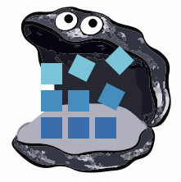


Under the covers
Artifact: registry.wabbit-networks.io/monitoring/net-monitor:v1
registry.wabbit-networks.io
The Artifact
Manifests
net-monitor:v1
<-> REST
Manifest
.json document¹
net-monitor:v1
net-monitor:v1.1
net-scan:v12
blob1
blobs
cf4ecb49238476635f551fe11987ae4c3
blob2
e41864ee12411ff073f0a58417cf7e160
85bef57c324acc96f7067488d35b7e3c1
blob3
1d57d886885835cbc52c2d85fe0ce008f
f78a85a7da099d7494a5166a28e72a642
blob…
da3343b41a78a0bcd4926d605b6fe37ba
c935edcb03a0660b347d2fbf6542ee068
Existing manifests happen to be .json, but can be any “document” type

Slide 20

Docker Pull
docker pull registry.wabbit-networks/net-monitor:v1
Pull:
I want this “thing”, represented by a collection of blobs
Container Host Service
Manifest:
What layers do I already have? ^{(decompressed)}
registry.wabbit-networks.io
Manifests
1. Pull
Manifest:
List of blob ID’s representing the entire thing
Image Cache
IMAGE ID REPOSITORY TAG SIZE
694950fbcb3f wabbitnetworks/net-monitor v1 1.2B
2. Manifest Returned
net-monitor:v1
3. Delta of Blob Requests
net-monitor:v1.1
4. Blob URLs Returned
net-scan:v12
Layer Cache
LAYER ID
Blobs Please:
List of compressed blob URLs
blobs
5. Blob Request
cf4ecb49238476635f551fe11987ae4c3
sha256:cf4ecb49238476635f551fe11987ae4c3
sha256:e41864ee12411ff073f0a58417cf7e160
e41864ee12411ff073f0a58417cf7e160
85bef57c324acc96f7067488d35b7e3c1
6. Blobs Returned
1d57d886885835cbc52c2d85fe0ce008f
f78a85a7da099d7494a5166a28e72a642
da3343b41a78a0bcd4926d605b6fe37ba
c935edcb03a0660b347d2fbf6542ee068

Slide 21
Elegance - Manifest
{
"mediaType": "application/vnd.cncf.oras.artifact.manifest.v1+json",
"artifactType": "application/vnd.oci.image.manifest.v1+json",
"blobs": [
{
"mediaType": "application/vnd.oci.image.config.v1+json",
"digest": "sha256:e752324f….d0031cf06cdb3c7ad1625dcd1b399",
"size": 7097
},
{
"mediaType": "application/vnd.oci.image.layer.v1.tar+gzip",
"digest": "sha256:83c5cfdaa5…5d74de847a7bdd968555b8f2c558dac0e",
"size": 25851449
},
{
"mediaType": "application/vnd.oci.image.layer.v1.tar+gzip",
"digest": "sha256:7445693bd43e8246a8c166233392b33143f7f5e396c480f74538e5738fb6bd6e",
"size": 226
}
]
}
net-monitor:v1 aka net-monitor@sha256:abc123s1212...9a81b
Manifests provide:
Collections of Blobs (1* or more)
Descriptor
Type
Hash
Size (checksum)
Metadata through Annotations
{
"schemaVersion": 2,
"mediaType": "application/vnd.oci.image.manifest.v1+json",
"config": {
"mediaType": "application/vnd.oci.image.config.v1+json",
"digest": "sha256:e752324f6804d5d…d1625dcd1b399",
"size": 7097
},
"layers": [
{
"mediaType": "application/vnd.oci.image.layer.v1.tar+gzip",
"digest": "sha256:83c5cfdaa5385ea6…968555b8f2c558dac0e",
"size": 25851449
},
{
"mediaType": "application/vnd.oci.image.layer.v1.tar+gzip",
"digest": "sha256:7445693bd43e…96c480f74538e5738fb6bd6e",
"size": 226
} ,
"annotations": {
"example.sbom.author": "wabbit-networks.io"
}
]
}
{
"mediaType": "application/vnd.cncf.oras.artifact.manifest.v1+json",
"artifactType": "sbom/example",
"blobs": [
{
"mediaType": "application/tar",
"digest": "sha256:9834876dcfb05cb167a5c…8f2f9d09af107ee8f0",
"size": 32654
}
],
"subject": {
"mediaType": "application/vnd.oci.image.manifest.v1+json",
"digest": "sha256:73c803930ea3b…51fe7b00369da519a3c333",
"size": 16724
},
"annotations": {
"example.sbom.author": "wabbit-networks.io"
}
}

Slide 22
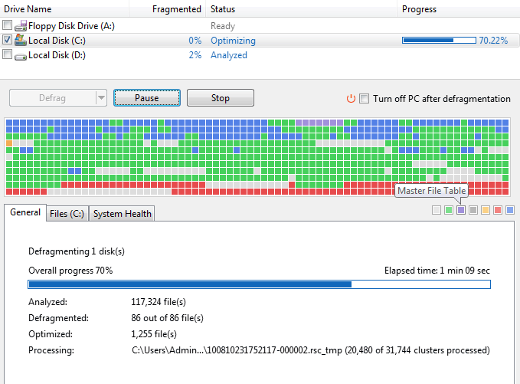
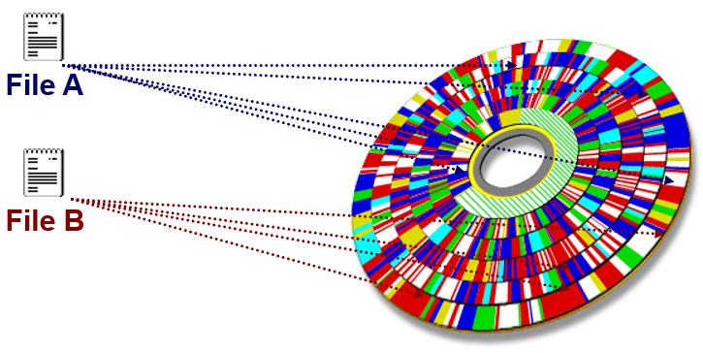
Files
foo.txt

Slide 23
Elegance - Manifest
Manifest = An Artifact (a container image is a type of artifact)
Blobs = The content of the thing, segmented into 1 or more blobs
Several Manifest Types
Docker Manifest application/vnd.docker.distribution.manifest.v2+json
OCI Image Manifest application/vnd.oci.image.manifest.v1+json
Docker Manifest List application/vnd.docker.distribution.manifest.list.v2+json
OCI Index application/vnd.oci.image.index.v1+json
… but wait, there’s more

Slide 24
Tags
put manifest
{
"mediaType": " application/vnd.oci.image.manifest.v1+json",
"digest": " sha256:83c5cfdaa5385ea6…968555b8f2c558dac0e",
"size": 12454
}
net-monitor:v1
put manifest {
"mediaType": " application/vnd.oci.image.manifest.v1+json",
"digest": " sha256: e752324f6804d5d…d1625dcd1b399",
"size": 12454
}

Slide 25
Elegance of Distribution
Manifest = Artifact
Blobs = content of the artifact
Blobs can/should be de-duped¹
Secured in namespaces
All content has unique identifiers (digests aka descriptors)
Tags = pointers to a unique manifest descriptor
Artifacts can be payloads from KB to GB and beyond
De-duping has security implications. Typically, de-duping within a controlled security boundary.

Slide 26
Kinda Useful
Is there anything really unique to container images?

Slide 27
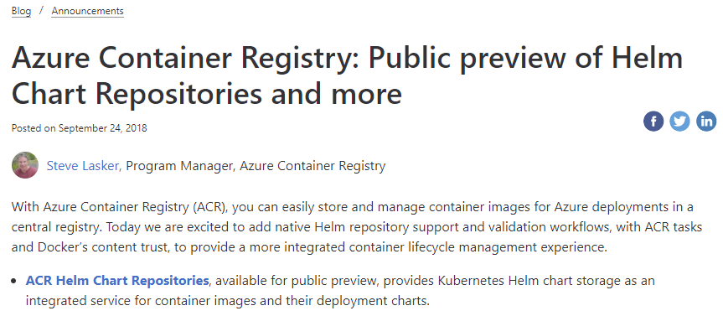

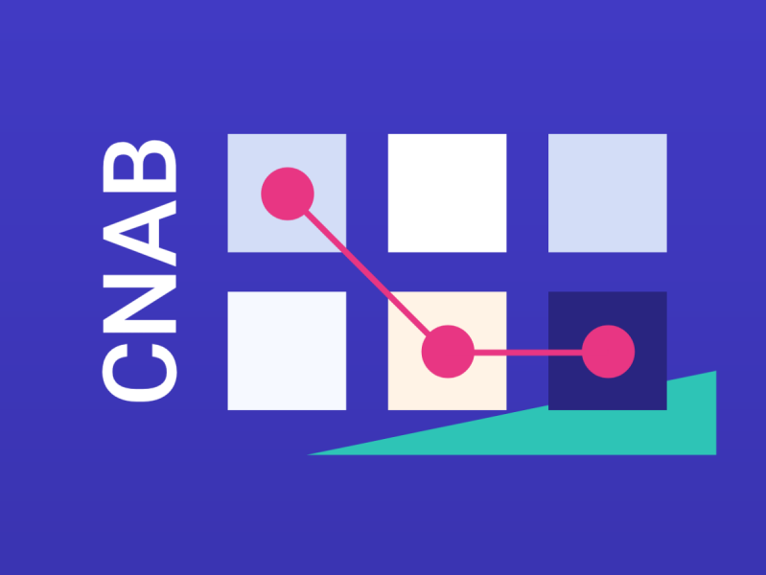




Adding Helm Repos to Azure Container Registry
http://aka.ms/acr/helm-repos
HELM 2
ACR Sprawl…
HELM 3 with OCI Artifacts
$ az acr cnab ...
$ az acr singularity ...
$ az acr msix ...
$ az acr terraform ...
$ az acr opa ...
$ az login
$ az acr helm repo add -r $registry
$ helm package ./wordpress
$ az acr helm push wordpress-5.7.tgz
$ helm fetch $registry/wordpress --version ..
$ helm registry login $registry -u $user -p $pwd
$ helm chart save wordpress/ $registry/wordpress:5.7
$ helm chart push $registry/wordpress:5.7
$ helm chart pull $registry/wordpress:5.7

Slide 28












Evolution
Container Registries
→ Artifact Registries
!
Y
Yet
Another
Storage
Solution
A
S
S

Slide 29
Registries for All types of Artifacts
Registries are ubiquitous across all cloud providers
Cloud, On-Prem, IoT
Support performance, reliability, security capabilities from dev→prod
Users want fewer services to run, configure & maintain
Artifact authors want to focus on their thing
Does the SPDX, CycloneDX, gitBOM, … want to design, spec, build, operate Yet Another Storage Service?

Slide 30
Correlation of Artifacts
How do you discover different artifact types?
Is there a relationship between the different types?
What is it your looking for?
What do you know?
Name of the artifact registry.wabbit-networks.io/monitoring/net-monitor:v1
What do you want to know?
Is it signed?
Does it have an SBOM, gitBOM, Scan Results, Claims
What is it’s current support, or revocation status?
SBOM
Scan Results
Claims
Licenses
gitBOM
Attestations
Policies
Docs
Deployment Templates

Slide 31
How…
OCI Artifacts generalized registries for all types – individual
ORAS Artifacts generalizes further, enabling referrers
Concepts
I want to use the original named reference (tag or digest)
I want to discover what’s related to the named artifact
I want to filter on specific artifact types
I want to sort the results, as there may be many (scan results)
I want to add metadata, to existing artifacts
I want to manage the lifecycle of the things as a whole
delete registry.acme-rockets.io/net-monitor:v1

Slide 32

Evolution
Investing in services that are already ubiquitous

Slide 33
Where to look for …
You already have a registry, that can store all sorts of stuff
What if…
You could ask the registry for what else it knows for the named thing?
oras discover registry.wabbit-networks.io/net-monitor:v1
registry.wabbit-networks.io/net-monitor:v1 ├── notary.v2.signature │ └── sha256:8c0e82624475a4ad64ddca2d68c0f82e316ec758591cb916049fe59eaf27b5b4 ├── snyk.scan-results.v1 │ ├── sha256:95b97532a5b2d0c36cfcefd403b02779fb5afca07479a66bd509a635d5681e7f │ ├── sha256:204e7c423c891d0e4b057c4ecb068a53ffc991ef5a3bb47467f1b8088775dc48
│ └── sha256:1b26826f602946860c279fce658f31050cff2c596583af237d971f4629b57792 ├── spdx.sbom.v3 │ └── sha256:82d89db16266d13ab7680badfea3dbd91fd8e311c3b4291d9c0d4f9cff86fa50
├── cyclonedx.sbom.v1 │ └── sha256:c5fbdddecc83f1af8743983ce114452b856b77e92a5c7f4075c0110ea1e35e38
└── gitbom.v1 └── sha256:fa31146981940964ced259bd2edd36c10277207e3be4d161bdb96e5e418fc2e0

Slide 34
Where to look for …
You already have a registry, that can store all sorts of stuff
What if…
You could filter for an artifactType, for your named thing
oras discover registry.wabbit-networks.io/net-monitor:v1 \ artifactType=snyk.scan-results.v1 orderBy=date order=desc
registry.wabbit-networks.io/net-monitor:v1 └── snyk.scan-results.v1 ├── sha256:95b97532a5b2d0c36cfcefd403b02779fb5afca07479a66bd509a635d5681e7f ├── sha256:204e7c423c891d0e4b057c4ecb068a53ffc991ef5a3bb47467f1b8088775dc48
└── sha256:1b26826f602946860c279fce658f31050cff2c596583af237d971f4629b57792

Slide 35
Where to look for …
You already have a registry, that can store all sorts of stuff
What if…
You could filter for an artifactType, for your named thing
oras discover registry.wabbit-networks.io/net-monitor:v1 \ artifactType=snyk.scan-results.v1 orderBy=date order=desc top=1
registry.wabbit-networks.io/net-monitor:v1 └── snyk.scan-results.v1 └── sha256:95b97532a5b2d0c36cfcefd403b02779fb5afca07479a66bd509a635d5681e7f

Slide 36
Demo
Adding references to existing images artifacts

Slide 37
Evolution: Extending Manifest Support
Registries already support multiple manifest types
What if we added a new, generic manifest, that could support related content?
Docker Manifest application/vnd.docker.distribution.manifest.v2+json
OCI Image Manifest application/vnd.oci.image.manifest.v1+json
Docker Manifest List application/vnd.docker.distribution.manifest.list.v2+json
OCI Index application/vnd.oci.image.index.v1+json
Artifact Manifest application/vnd.cncf.oras.artifact.manifest.v1+json

Slide 38
Evolution: New Artifact Manifest
registry.wabbit-networks.io/net-monitor:v1 artifactType = container runtime image
registry.wabbit-networks.io/net-monitor@sha256:abc123... artifactType = sbom/example
{
"mediaType": "application/vnd.oci.image.manifest.v1+json",
"config": {
"mediaType": "application/vnd.oci.image.config.v1+json",
"digest": "sha256:e752324f6804d5d…d1625dcd1b399",
"size": 7097
},
"layers": [
{
"mediaType": "application/vnd.oci.image.layer.v1.tar+gzip",
"digest": "sha256:83c5cfdaa5385ea6…968555b8f2c558dac0e",
"size": 25851449
},
{
"mediaType": "application/vnd.oci.image.layer.v1.tar+gzip",
"digest": "sha256:7445693bd43e…96c480f74538e5738fb6bd6e",
"size": 226
} ,
"annotations": {
"example.sbom.author": "wabbit-networks.io"
}
]
}
{
"mediaType": "application/vnd.cncf.oras.artifact.manifest.v1+json",
"artifactType": "sbom/example",
"blobs": [
{
"mediaType": "application/tar",
"digest": "sha256:9834876dcfb05cb167a5c…8f2f9d09af107ee8f0",
"size": 32654
},
{
"mediaType": "sbom/example.config.v1+json",
"digest": "sha256:e752324f6804d5d…d1625dcd1b399",
"size": 7097
}
],
"subject": {
"mediaType": "application/vnd.oci.image.manifest.v1+json",
"digest": "sha256:73c803930ea3b…51fe7b00369da519a3c333",
"size": 16724
},
"annotations": {
“org.cncf.oras.artifact.created": “2022:05:02T08:24:33:53“,
"example.sbom.author": "wabbit-networks.io"
}
}
{
"mediaType": "application/vnd.cncf.oras.artifact.manifest.v1+json",
"artifactType": "application/vnd.oci.image.manifest.v1+json",
"blobs": [
{
"mediaType": "application/vnd.oci.image.config.v1+json",
"digest": "sha256:e752324f….d0031cf06cdb3c7ad1625dcd1b399",
"size": 7097
},
{
"mediaType": "application/vnd.oci.image.layer.v1.tar+gzip",
"digest": "sha256:83c5cfdaa5…5d74de847a7bdd968555b8f2c558dac0e",
"size": 25851449
},
{
"mediaType": "application/vnd.oci.image.layer.v1.tar+gzip",
"digest": "sha256:7445693bd43e8246a8c166233392b33143f7f5e396c480f74538e5738fb6bd6e",
"size": 226
}
]
}

Slide 39
Evolution: Manifest
Additional annotations
Information added after initial creation
No blobs, just annotations
Annotations may be indexed for querying across various artifacts
{
"mediaType": "application/vnd.cncf.oras.artifact.manifest.v1+json",
"artifactType": “application/vnd.cncf.oras.v1.annotations/",
"subject": {
"mediaType": "application/vnd.oci.image.manifest.v1+json",
"digest": "sha256:73c803930ea3b…51fe7b00369da519a3c333",
"size": 16724
},
"annotations": {
“org.cncf.oras.artifact.new-version": “net-monitor:v2@sha256:abc123"
}
}
Return all artifacts (descriptors) with artifact.deletion-date < today

Slide 40
Evolution: Referrers API
Template
GET /v2/{repository}/_oras/artifacts/referrers?digest={digest}
Example GET /v2/net-monitor/_oras/artifacts/referrers?digest=sha256:3c3a4604a545cd…
{
"referrers": [
{
"digest": "sha256:3c3a4604a545cdc127456d94e421cd355bca5b528f4a9c1905b15da2eb4a4c6b",
"mediaType": "application/vnd.cncf.oras.artifact.manifest.v1+json",
"artifactType": "signature/example",
"size": 312
},
{
"digest": "sha256:3c3a4604a545cdc127456d94e421cd355bca5b528f4a9c1905b15da2eb4a4c6b",
"mediaType": "application/vnd.cncf.oras.artifact.manifest.v1+json",
"artifactType": "sbom/example",
"size": 237
}
]
}
github.com/oras-project/artifacts-spec/blob/main/manifest-referrers-api.md

Slide 41
Promoting Artifacts
How to promote a graph of artifacts?
Several tools were used to create various artifacts
Container Build Tools (Docker)
SBoM Creation (CycloneDX, SPDX)
Image Scan Results (Aqua, Palo Alto, Snyk)
Signatures (Notary, Cosign)
Should each tool be used to promote the graph?

Slide 42
Artifact: Reference Type Principals
Multiple artifacts exist, and none should have to create YASS
Persisted alongside the subject artifact
Solves the discovery problem & network isolated/air-gapped environments
Reference Types artifacts can be copied with the target artifact
Associated with, but separable from the target artifact
Solves the trojan horse validation challenge
Target artifact must not change when adding new artifacts
docker pull registry.acme-rockets.io/net-monitor:v1
docker pull registry.acme-rockets.io/net-monitor@sha256:ca9c27f79cfc66befcd93f...
Helm chart references
Kubedeploy.yaml references
1- YASS- Yet Another Storage Service

Slide 43




Thank You
OCI Artifacts: github.com/opencontainers/artifacts
ORAS Artifact (Reference Types): github.com/oras-project/artifacts-spec
ORAS CLI: github.com/oras-project/oras
ORAS Library: github.com/oras-project/oras-go
CNCF Distribution Reference Types: github.com/oras-project/distribution
OCI Reference Types Working Group: github.com/opencontainers/wg-reference-types
Steve Lasker
Principal PM Architect
Azure
Steve.Lasker@Microsoft.com
@SteveLasker
SteveLasker.blog
github.com/SteveLasker
github.com/SteveLasker/presentations

